Slide 1
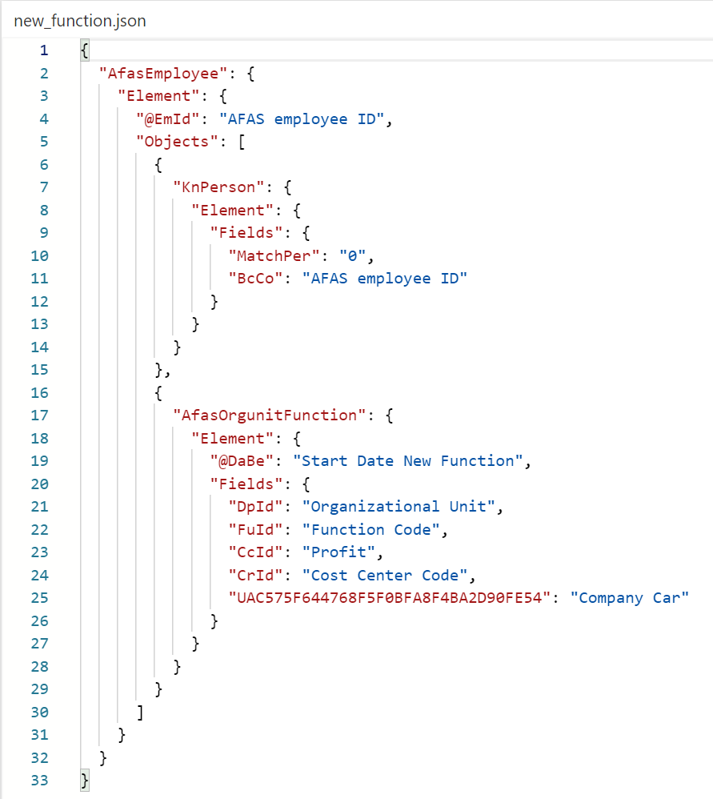
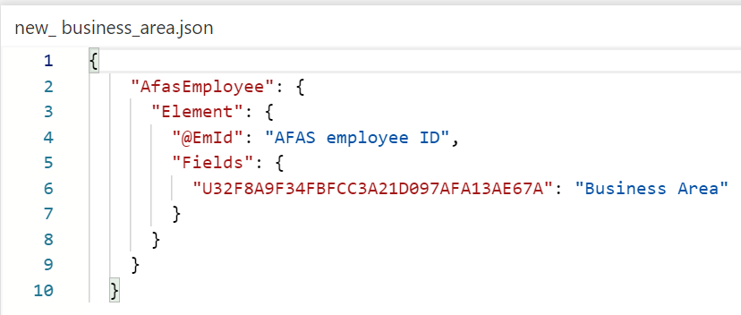
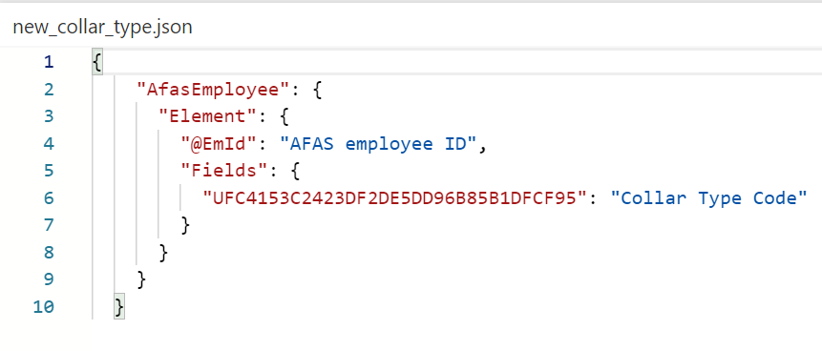
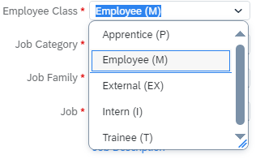
Job information Change – promotion / demotion
Payload new function/ new collar type/ new business area?
Start proces | SuccesFactors | AFAS | Comments
MSS – manager start functiewijziging op in SF | Job information Change Velden gekoppeld aan de positie cursief maken! | Nieuwe functieregel | Combined WF: Promotion/demotion + tranfer legal entity Transfer lateral move + transfer legal entity Job change + Compensation change
Workflow in SF: Promotion / Demotion Transfer – Lateral move (functiewijziging zonder wijziging in salary grade) Event reasons: Reclassification / Demotion Promotion Lateral Move | SF Fields: Effective date / payroll ID BU/division Department cost center location group / location Manager position title job catalogue employment type (Blue collar / white collar) employee type (paid/not paid) employee class (apprentice, employee, external, intern, trainee) permanent / temporary FTE, is fulltime employee, standard weekly hours salary grade Probationary end date contract end date. | Payload trigger new function: Start date new function / medewerkercode Payload BA? Organizational unit Cost center code Payload: ? n/a Function code n/a Payload: new collar type n/a Checken payload new contract / rehire? n/a n/a > nieuw veld AFAS n/a? Payload: new contract payload? | Salary grade to add to payload and to AFAS. Company car > compensation change WF Is location part of any payload? And do we want to have it in somewhere? (under “Volvo overig” in AFAS just as Business Area and Collar type) New contract payload doesn’t contain enddate – check sheet new contract payload for more details.

Slide 2
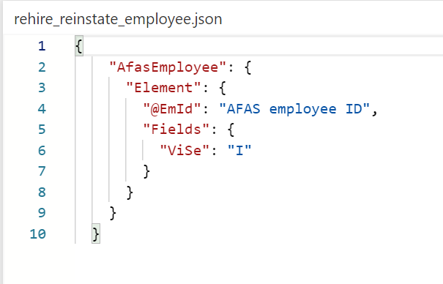
Job information Change – transfer LE
Payload rehire
Start proces | SuccesFactors | AFAS | Comments
MSS – manager start functiewijziging op in SF | Job information Change | Rehire | Combined WF: Promotion/demotion + tranfer legal entity Transfer lateral move + transfer legal entity Job change + Compensation change
Workflow in SF: Transfer - Legal Entity (nieuwe functie binnen andere BV in NL of daarbuiten) Event reasons: Lateral Transfer | SF Fields: Same as promotion/demotion/transfer Added: Legal entity | Payload trigger: Same as promotion/demotion/ transfer Change of LE should trigger: Rehire | Transfer of legal entity means rehire in AFAS with new contract.

Slide 3
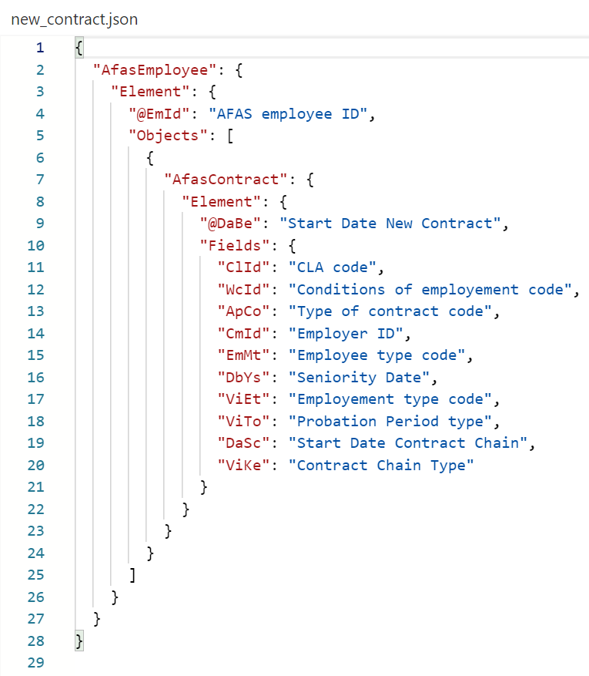
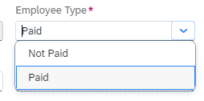
Job information Change – new contract?
Concept
Payload New Contract
Start proces | SuccesFactors | AFAS | Comments
MSS – manager start functiewijziging op in SF | Job information Change - without change of position | Nieuwe contractregel
Workflow SF: ​Job Information Contract Change Job information Data change | SF Fields: Effective date / payroll ID Legal Entity Contract end date Contract type How do we make sure all payload fields are filled? Are they all mandatory? | Payload trigger new contract: Start date new function / mwcode Employer ID + match CLA code End date? Type of contract code = tabel? | Legal entity needs to match CLA code (NL18 = 01, NL24 =03, NL28 =04 is basis / NL20 = 02 is MTB) To which payload belongs enddate contract – do we need to add it somewhere? Where can you change contract type? Waar passen we bijv seniority date aan?
Event reasons: Extension of Probation Period (N/A) Job Classification Change (N/A) Change in schedule (N/A) Employee class change Change of Contract Other Data Change |  | Payload event reasons: N/A. N/A N/A. New contract of Rehire? Payload new contract …? | Geen connectie Job catalogue? – geen connectie FTE / werkuren WF in AFAS starten – geen connectie. Nieuw dienstverband = rehire willen we dit koppelen? Check is dit contract type of contract end date? Which fields contains Event Reason other data change?

Slide 4
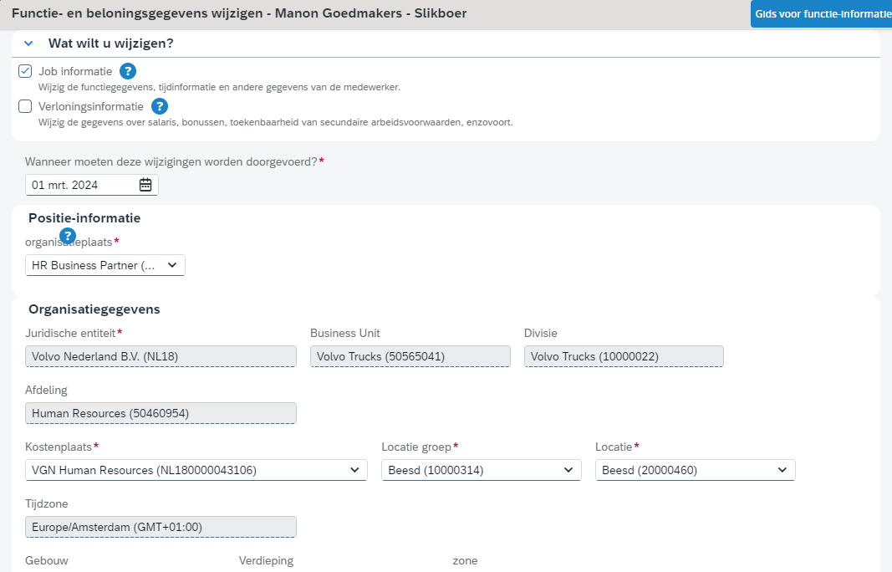
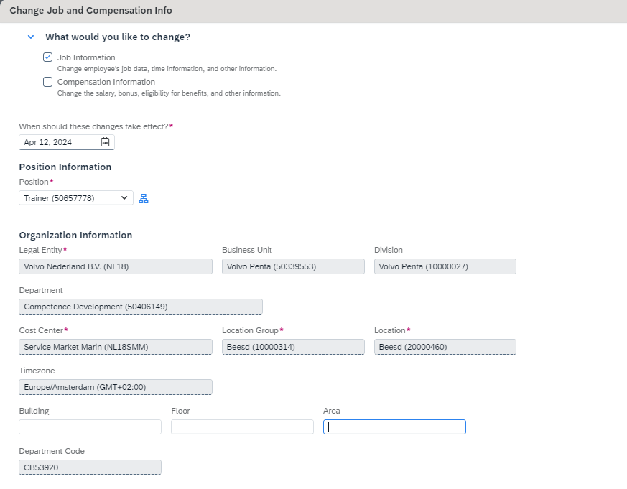
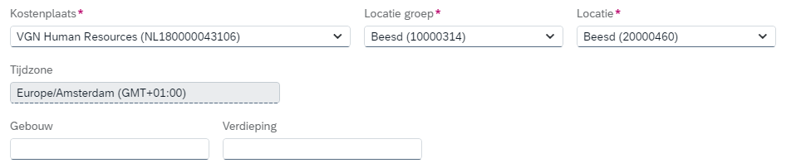

Slide 5
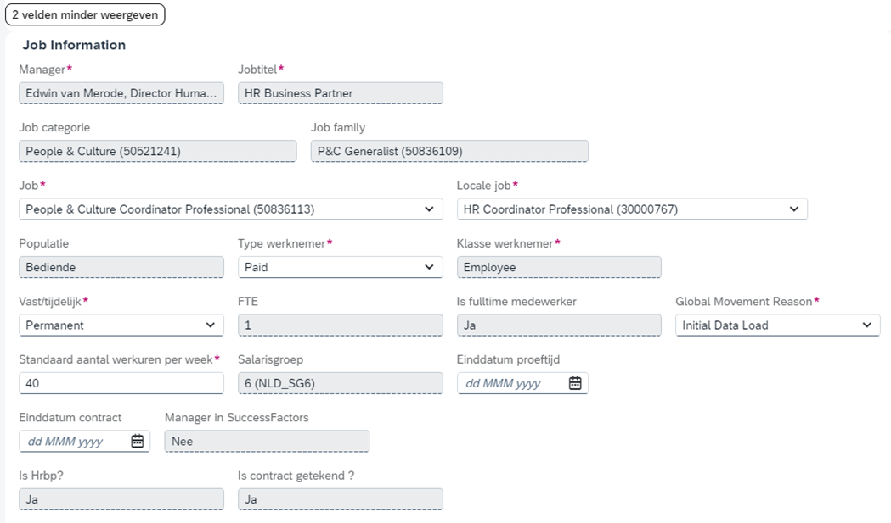
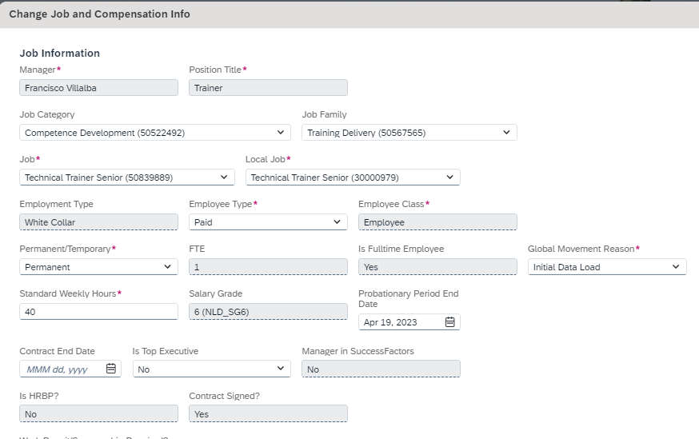

Slide 6
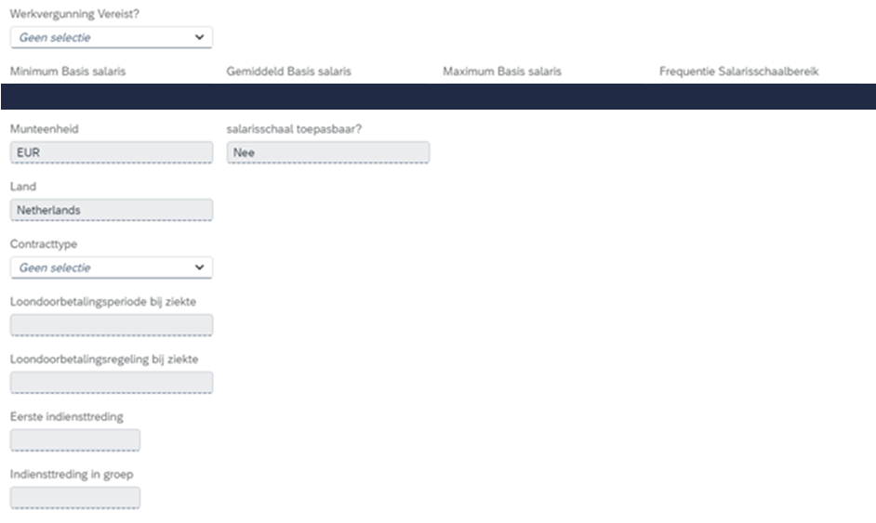
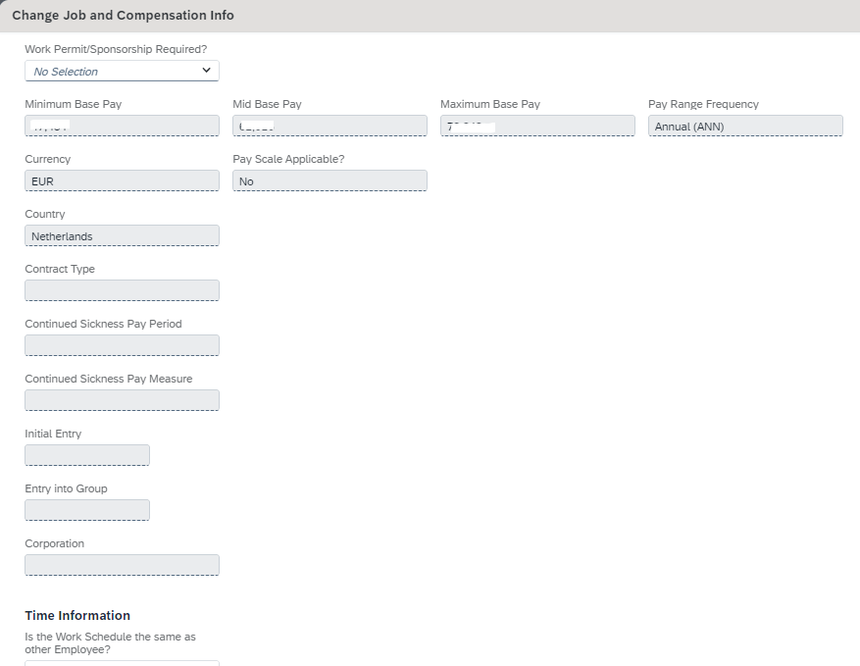

Slide 7
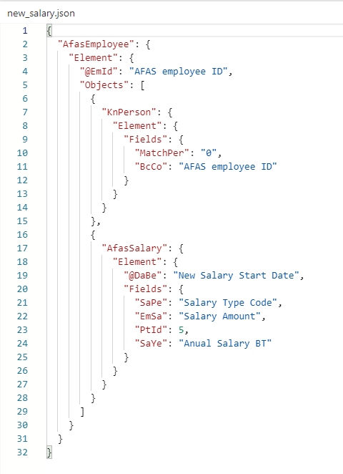
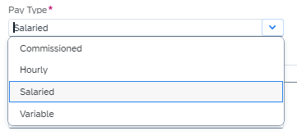
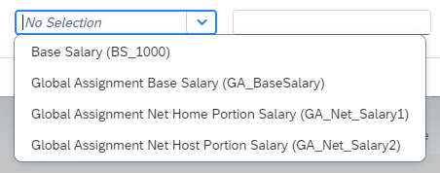
Compensation change - salariswijziging
Payload new salary
Start proces | SuccesFactors | AFAS | Comments
MSS – manager start compensatiewijziging op in SF | Compensation information change | Nieuwe salarisregel | Combined WF: Job change + Compensation change
Workflow in SF: Pay rate change Event reasons: Acting Allowance/ Additional Salary Annual Salary Review Collective Labor Agreement Adjustment Company Car Eligibility General Flat rate increase Individual Salary Change (Promotion/Demotion/Lateral Movement) Legal and compliant adjustment Seniority Wage Progression Long Term Incentive Short Term Incentive Company Bonus One Time Bonus Production Bonus Global assignment / hire-rehire / no change to pay | SF Fields Effective date / payroll ID Country (NLD) Pay Change Reason Pay Type Pay Group Eligible for Benefit (y/n) Eligible for Car (y/n) Checked with manager (y/n) Payroll ID Pay Component = Base Salary Amount Currency = EUR Frequency (monthly 13,32) | Payload trigger new salary: Start date new function / mwcode N/A N/A Salary Type code (U, V) Monthly – PtID 5 Payload bonus? Payload new function N/A Mw code N/A? Salary Amount N/A N/A | What to do with Annual Salary BT (Taroen) Acting allowance – not an option for NL in SF?

Slide 8
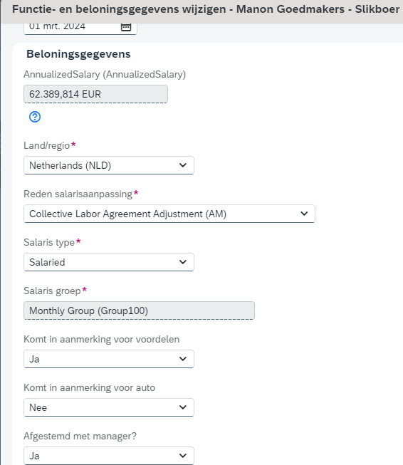
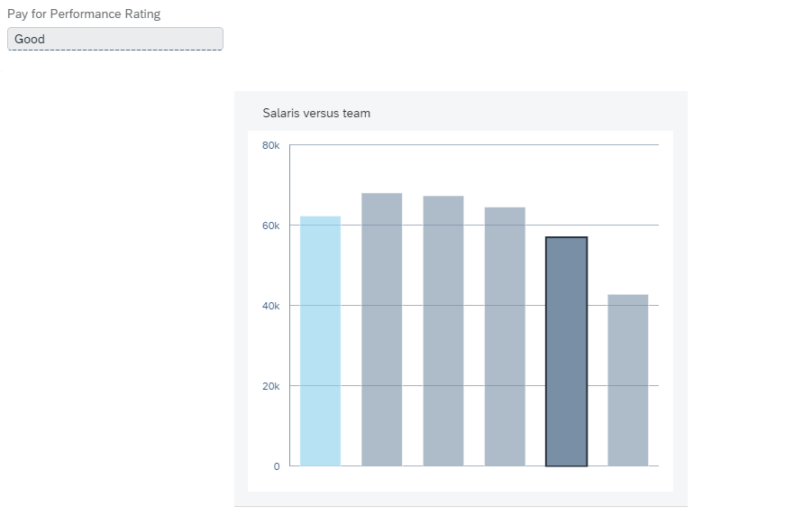
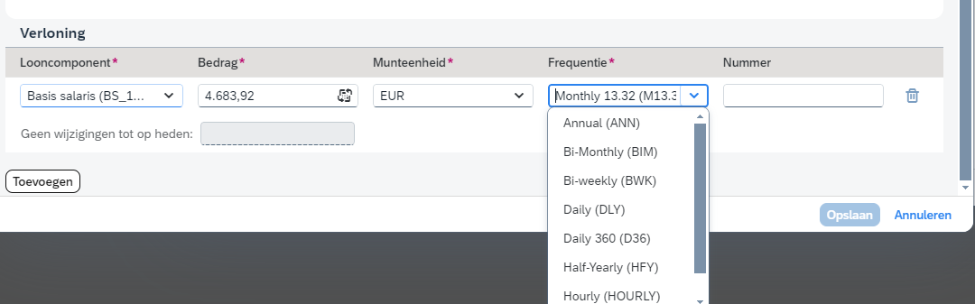

Slide 9
